Slide 1




Towards Generalist Medical AI
Benyou Wang
June 13th, 2026
The Chinese University of Hong Kong, Shenzhen
Shenzhen Loop Area Institute
1

Slide 2
About me
2018-2022, Phd, University of Padova
2022-~, The Chinese University of Hong Kong, Shenzhen (CUHKSZ)
Assistant professor in School of Data Science, School of Medicine in CUHKSZ, as well as the Shenzhen Loop Area Institute (SLAI 深圳市河套学院).
Research:
- Planning of Agent (complex reasoning/math modeling/automatic theorem proof)
- Perception of Agent (audio, vision, time-series, etc.)
- Human-agent interaction (HCI, agent simulation, etc.)
- Applications of Agent (Medical Applications)
Best papers:
- Best paper Honorable mention for SIGIR 2017
- NAACL 2019 Best Explainable NLP paper
- NLPCC 2022 Best Paper
- ICLR 2025 Financial AI 2025
HuggingFace: https://huggingface.co/FreedomIntelligence
GitHub: https://github.com/FreedomIntelligence

Slide 3
Timeline
2023 May, HuatuoGPT: Taming Language Models to Be a Doctor. Findings of EMNLP 2023.
2023 May, Huatuo-26M: the largest medical QA dataset
2023 Nov, HuatuoGPT-II: One-stage Training for Medical Adaptation of LLMs. COLM 2024.
2023 CMB benchmark, a popular Chinese benchmark on Medical domain.
2024 March, Apollo: multilingual medical LLMs for 6 languages
2024 June, HuatuoGPT-Vision: Injecting Medical Visual Knowledge into Multimodal LLMs at Scale. EMNLP 2024.
2024 Oct, HuatuoGPT deployed in 12 local hospitals
2024 Nov. Apollo 2: multilingual medical LLMs for 50 languages
2024 Dec, HuatuoGPT-o1: Towards Medical Complex Reasoning with LLMs
2025 June, MedGen: the medical video generation model
2025 August, ShizhenGPT : the first medical LLMs supporting full modalities for the traditional medicine
2025 Dec., DentalGPT: a specified LLM (牙科大模型)
[1] Junying Chen, Zhenyang Cai, Ke Ji, Xidong Wang, Wanlong Liu, Rongsheng Wang, Jianye Hou, Benyou Wang. HuatuoGPT-o1, Towards Medical Complex Reasoning with LLMs. https://arxiv.org/abs/2412.18925
[2] Junying Chen, Ruyi Ouyang, Anningzhe Gao, Shunian Chen, Guiming Hardy Chen, Xidong Wang, Ruifei Zhang, Zhenyang Cai, Ke Ji, Guangjun Yu, Xiang Wan, Benyou Wang. HuatuoGPT-Vision, Towards Injecting Medical Visual Knowledge into Multimodal LLMs at Scale. https://arxiv.org/abs/2406.19280. EMNLP 2024
[3] Junying Chen, Xidong Wang, Anningzhe Gao#, Feng Jiang, Shunian Chen, Hongbo Zhang, Dingjie Song, Wenya Xie, Chuyi Kong, Jianquan Li, Xiang Wan, Haizhou Li, Benyou Wang. Huatuogpt-ii, one-stage training for medical adaption of llms. https://arxiv.org/abs/2311.09774. COLM 2024
[4] Hongbo Zhang, Junying Chen, Feng Jiang, Fei Yu, Zhihong Chen, Jianquan Li, Guiming Chen, Xiangbo Wu, Zhiyi Zhang, Qingying Xiao, Xiang Wan, Benyou Wang, Haizhou Li. HuatuoGPT, towards Taming Language Model to Be a Doctor. https://arxiv.org/abs/2305.15075. Findings of EMNLP 2023
[5] Zhihong Chen, Shizhe Diao, Benyou Wang, Guanbin Li, and Xiang Wan. "Towards Unifying Medical Vision-and-Language Pre-training via Soft Prompts". ICCV 2023
[6] Xidong Wang, Guiming Hardy Chen, Dingjie Song, Zhiyi Zhang, Zhihong Chen, Qingying Xiao, Feng Jiang, Jianquan Li, Xiang Wan, Benyou Wang, Haizhou Li .CMB: A Comprehensive Medical Benchmark in Chinese. NAACL 2024
[7] Jianquan Li, Xidong Wang, Xiangbo Wu, Zhiyi Zhang, Xiaolong Xu, Jie Fu, Prayag Tiwari, Xiang Wan, Benyou Wang. Huatuo-26M, a Large-scale Chinese Medical QA Dataset. Findings of NAACL 2025. https://arxiv.org/abs/2305.01526

Slide 4
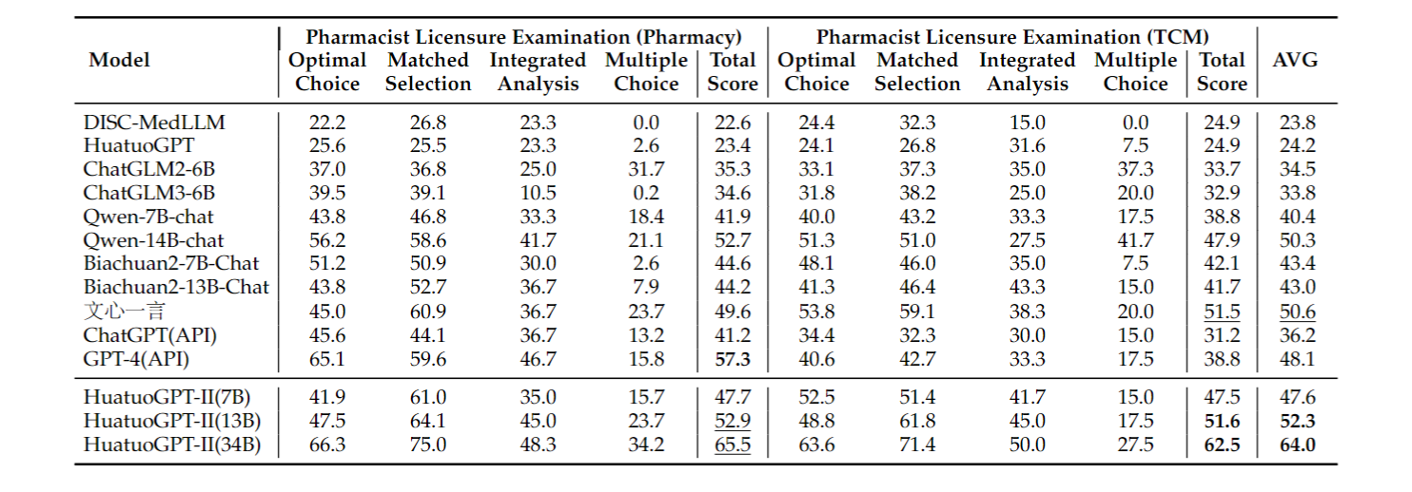
首个通过国家药剂师考试. (2023）
Benchmark is in Oct, where models are trained during Oct and cheating is impossible
Hongbo Zhang, Junying Chen, Feng Jiang, Fei Yu, Zhihong Chen, Jianquan Li, Guiming Chen, Xiangbo Wu, Zhiyi Zhang, Qingying Xiao, Xiang Wan, Benyou Wang#, Haizhou Li. HuatuoGPT, towards Taming Language Model to Be a Doctor. https://arxiv.org/abs/2305.15075
Junying Chen, Xidong Wang, Anningzhe Gao#, Feng Jiang, Shunian Chen, Hongbo Zhang, Dingjie Song, Wenya Xie, Chuyi Kong, Jianquan Li, Xiang Wan, Haizhou Li, Benyou Wang#. Huatuogpt-ii, one-stage training for medical adaption of llms. https://arxiv.org/abs/2311.09774

Slide 5
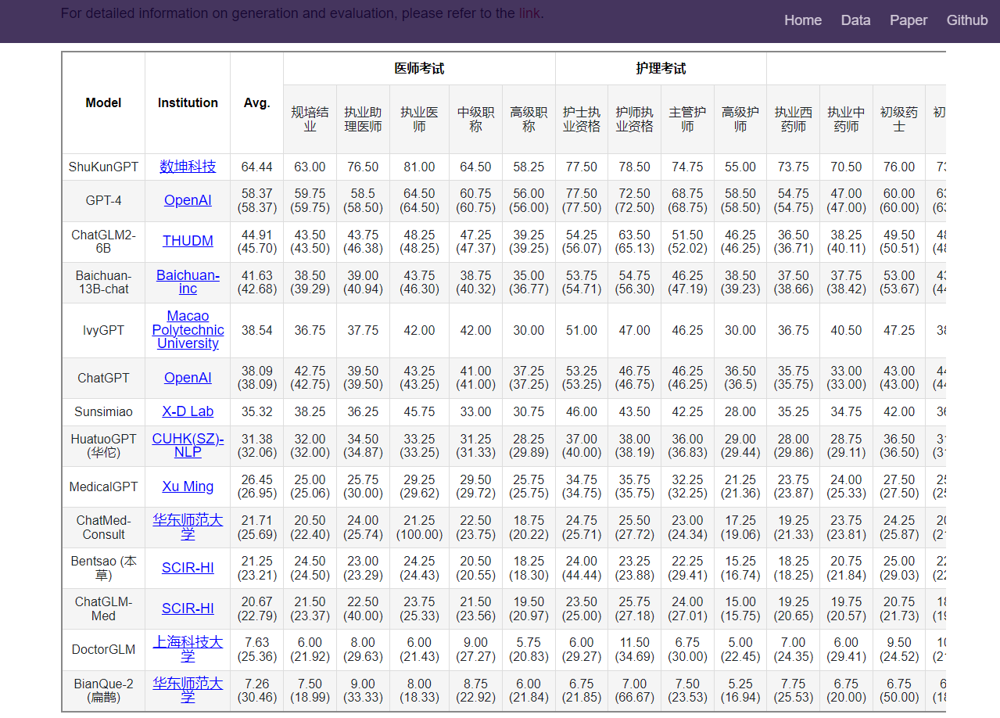
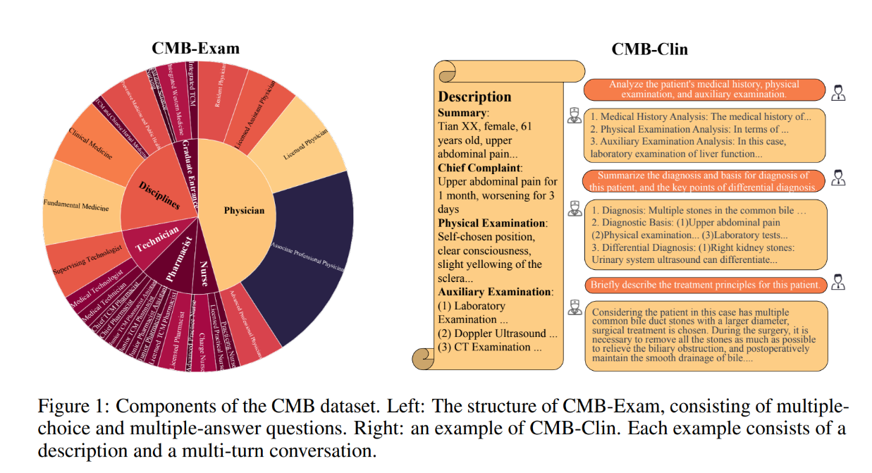
Medical benchmark
Xidong Wang, Guiming Hardy Chen, Dingjie Song, Zhiyi Zhang, Zhihong Chen, Qingying Xiao, Feng Jiang, Jianquan Li, Xiang Wan, Benyou Wang*, Haizhou Li .CMB: A Comprehensive Medical Benchmark in Chinese. NAACL 2024

Slide 6
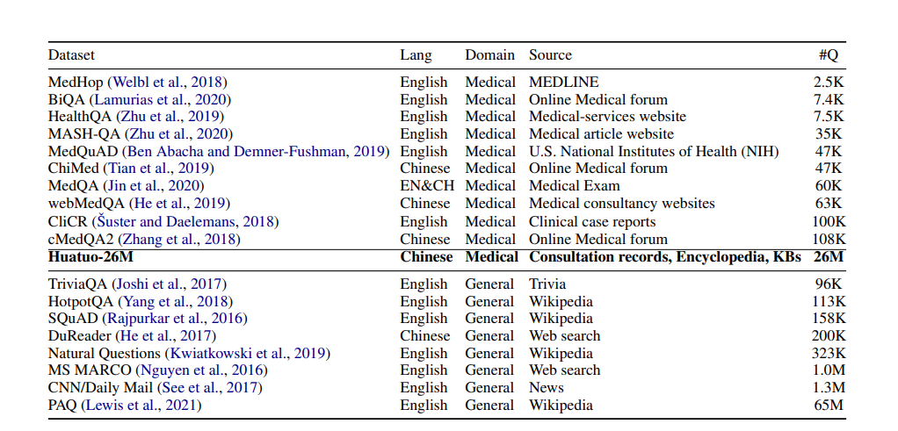
The largest medical QA dataset: Huatuo-26M
Jianquan Li, Xidong Wang, Xiangbo Wu, Zhiyi Zhang, Xiaolong Xu, Jie Fu, Prayag Tiwari, Xiang Wan, Benyou Wang. Huatuo-26M, a Large-scale Chinese Medical QA Dataset. https://arxiv.org/abs/2305.01526

Slide 7
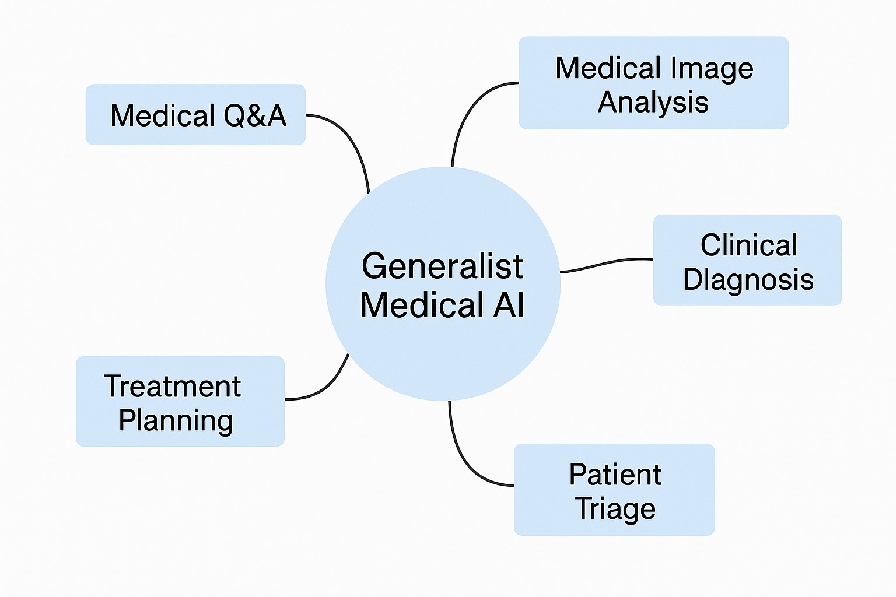
What is Generalist Medical AI (GMAI)
Similarly to Artificial General Intelligence (AGI)
GMAI: one model for every medical applications with little adaptions.
Why？
  mutual benefits between tasks （specially in scenarios with limited data）
  deployment efficiency

Slide 8
Why Generalist Medical AI is language–centric ?
Language has massive knowledge
  “The sun rises in the east”
Language is a great tool for communication
  The interface between Humans and Machines
Language can reason and plan
  Language is the Medium of thought (思考的介质)
more (full) modality out
LLMs
Longer context
Better reasoning
more (full) modality in

Slide 9
Generalist Medical AI: Top-down or bottom-up?
GMAI is the final goal
The road towards this goal might involves different specialized Multi-modal LLMs
Open AI develop one model for all
Better model backbone
Better insights/data/benchmark
Different specialized models and merge them

Slide 10
Roadmap to Generalist Medical AI (GMAI)
What is Generalist Medical AI?
Roadmap to Generalist Medical AI
  Perception :
    I) Multi-modal Perception
      Images (ALLaVA)，Speech (SoundWave)，EEG (WaveMind)，Motion (MotionLLM)，TCM (ShizhenGPT)
    II) Longer Context
      MileBench, LongLLaVa
  Cognition: III) Better Reasoning
  Interaction:
    IV) Multi-modal Generation
      Speech (Echo-X)，Images (Janus-4o)，Video (MedGen)，Micro World Simulation (MicroVerse)
    V) Agent Simulation : Twin Hospital
  Multilingual Support
    VI) Multilingual Medical LLMs: Apollo
Challenges of GMAI and Solutions
  Generalist Medical LLMs vs. Specialized Medical LLMs
  Trustworthiness and interpretation
  Lack Challenging Benchmark

Slide 11
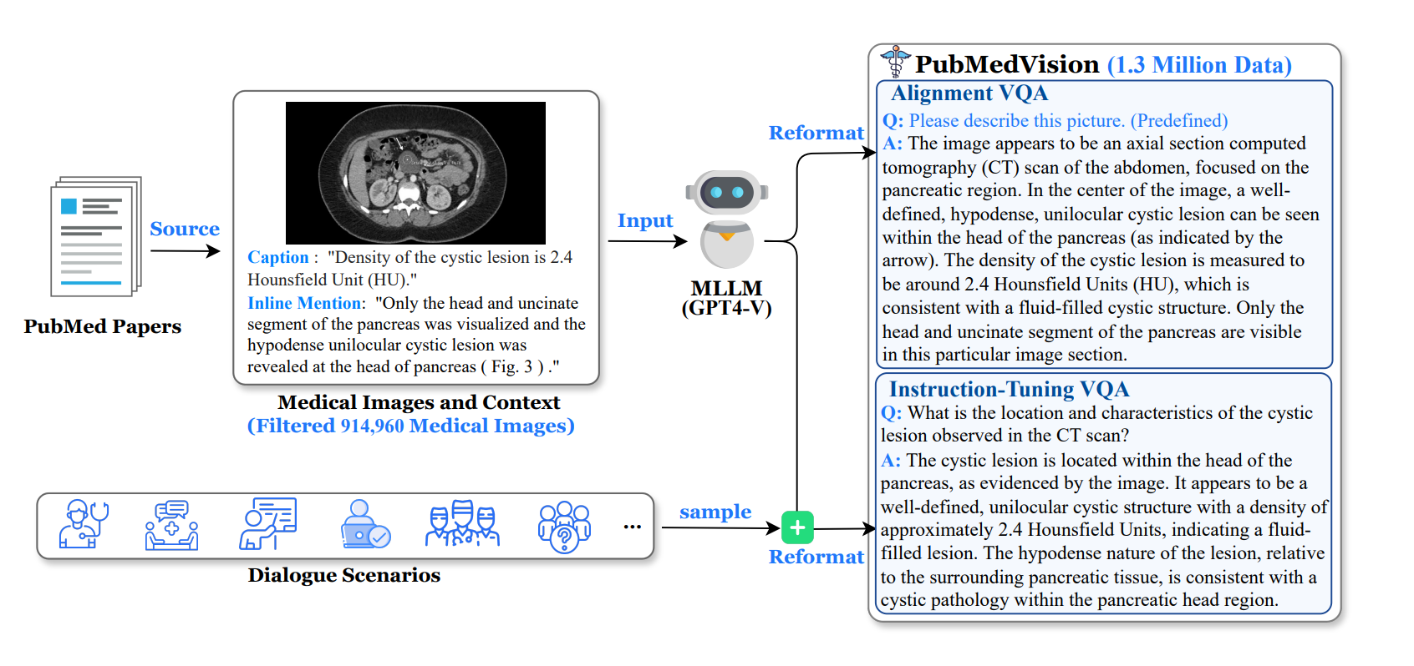
I) HuatuoGPT-Vision: Injecting Multimodal Medical knowledge
Junying Chen, Chi Gui, Ruyi Ouyang, Anningzhe Gao, Shunian Chen, Guiming Hardy Chen, Xidong Wang, Ruifei Zhang, Zhenyang Cai, Ke Ji, Guangjun Yu, Xiang Wan, Benyou Wang. HuatuoGPT-Vision, Towards Injecting Medical Visual Knowledge into Multimodal LLMs at Scale. EMNLP 2024 https://arxiv.org/abs/2406.19280

Slide 12
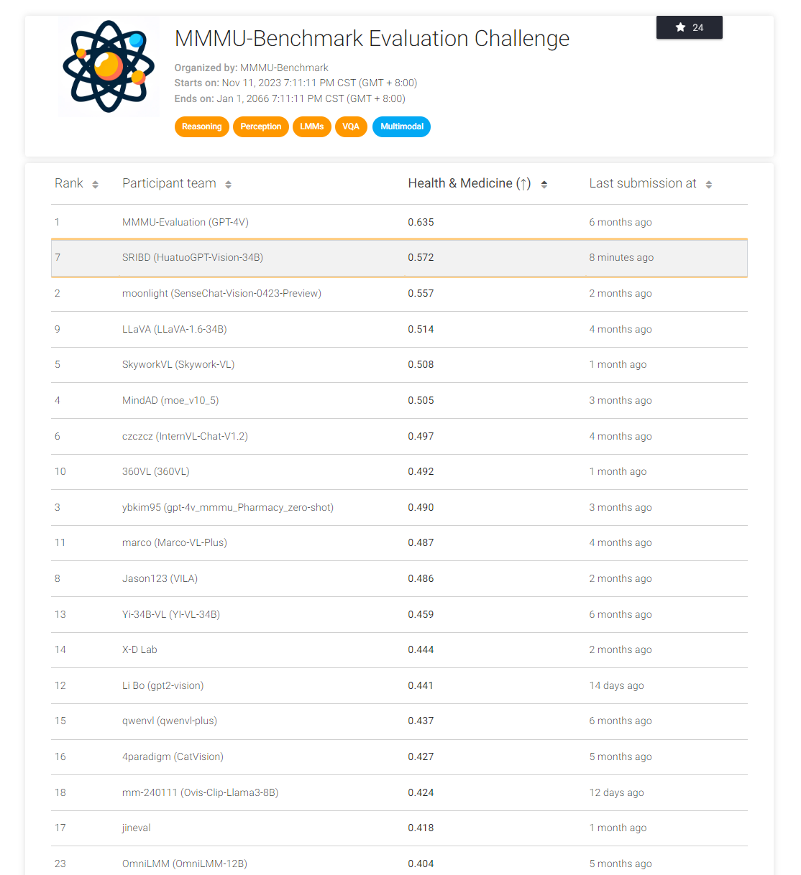
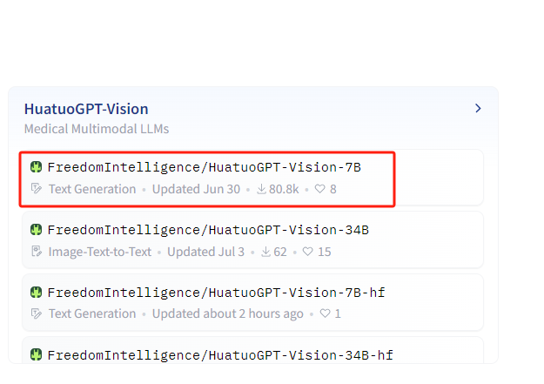
Maximum 200K model downloading per month

Slide 13
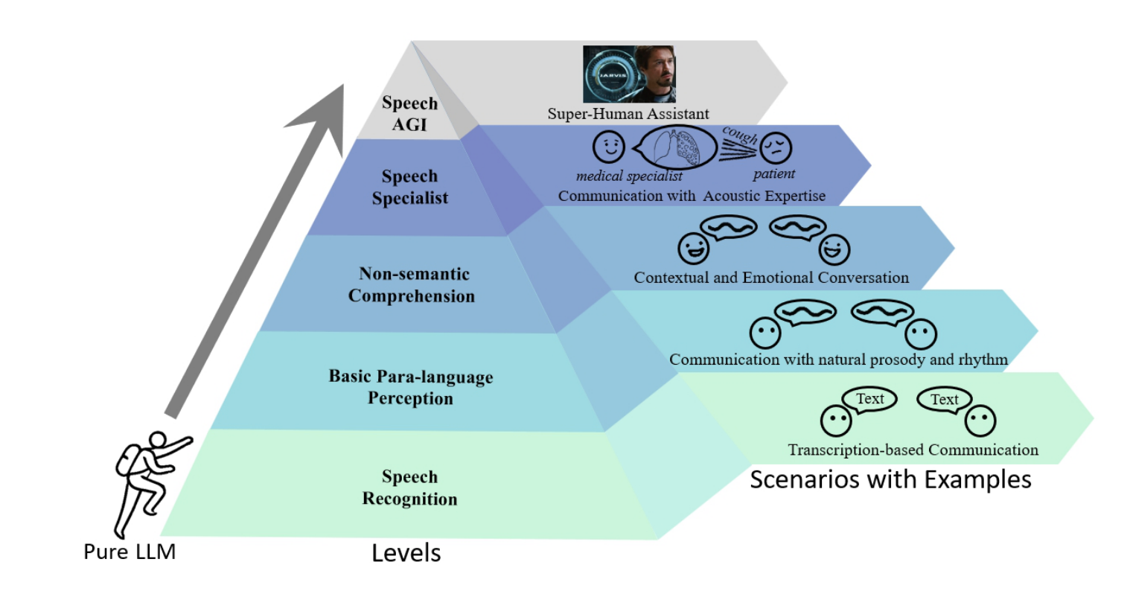
I) + Speech
Five Levels for Speech Understanding using LLMs
Fan Bu, Yuhao Zhang, Xidong Wang, Benyou Wang, Qun Liu, Haizhou Li. Roadmap towards Superhuman Speech Understanding using Large Language Models. https://arxiv.org/abs/2410.13268

Slide 14
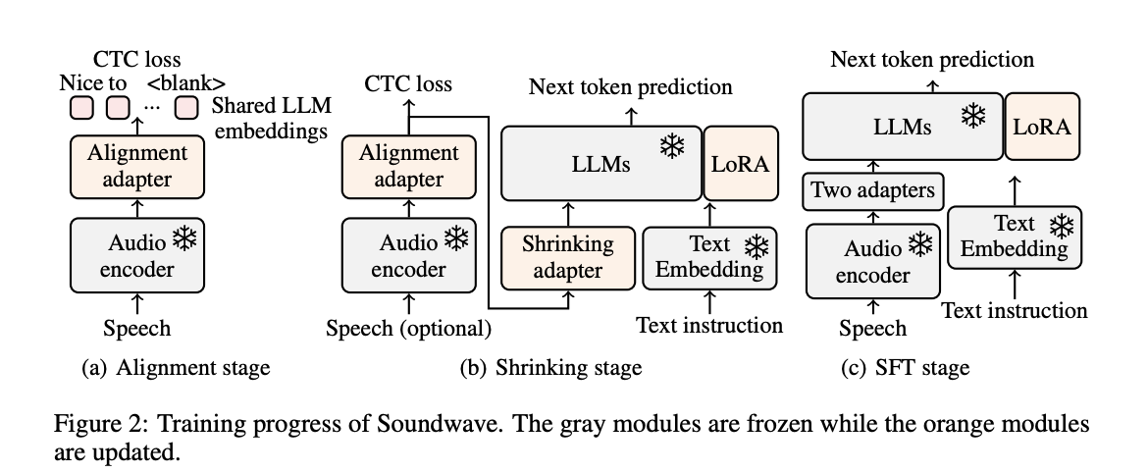
I) + Speech
Achieving better performance using 1/50 data compared to Qwen 2- Audio
Yuhao Zhang, Zhiheng Liu, Fan Bu, Ruiyu Zhang, Benyou Wang, Haizhou Li. Soundwave: Less is More for Speech-Text Alignment in LLMs. ACL 2025

Slide 15
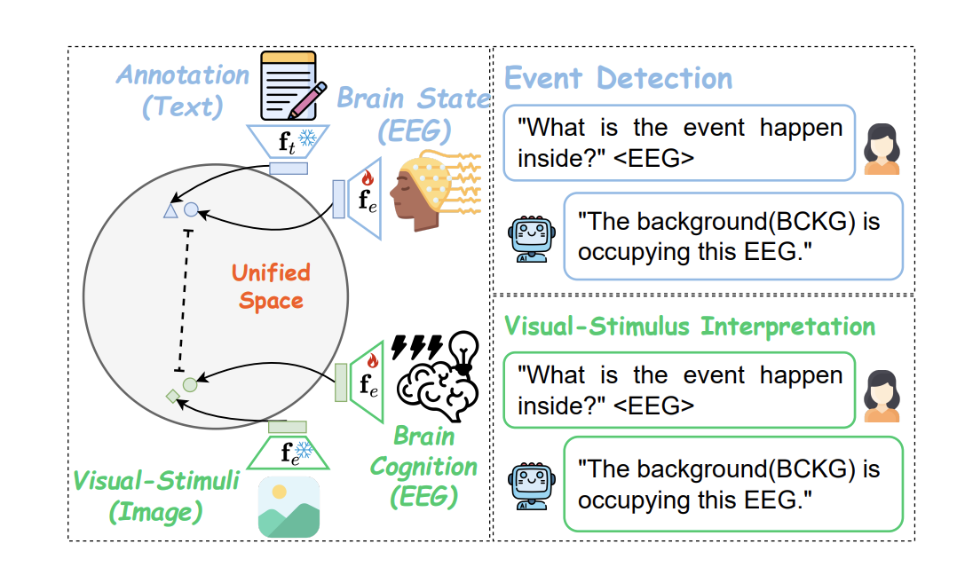
I) + EEG
Alingning EEG with texts and images!
Ziyi Zeng, Zhenyang Cai, Yixi Cai, Xidong Wang, Junying Chen, Rongsheng Wang, Yipeng Liu, Siqi Cai, Benyou Wang, Zhiguo Zhang, Haizhou Li. WaveMind: Towards a Conversational EEG Foundation Model Aligned to Textual and Visual Modalities. https://arxiv.org/abs/2510.00032

Slide 16
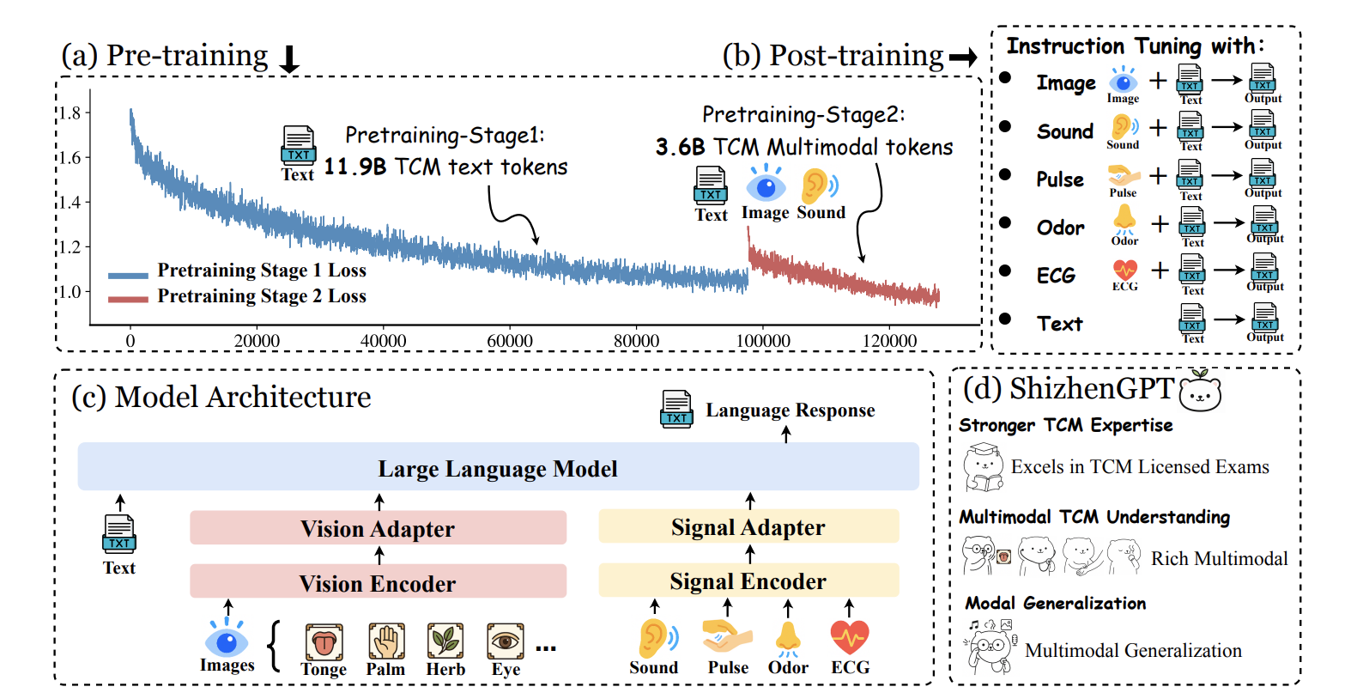
I) + 望闻问切 - ShizhenGPT (时珍GPT)
First unified model that supports “seeing, smelling, listening, and pulse” for Traditional Chinese Medicine
Junying Chen, Zhenyang Cai, Zhiheng Liu, Yunjin Yang, Rongsheng Wang, Qingying Xiao, Xiangyi Feng, Zhan Su, Jing Guo, Xiang Wan, Guangjun Yu, Haizhou Li, Benyou Wang. ShizhenGPT: Towards Multimodal LLMs for Traditional Chinese Medicine. https://arxiv.org/abs/2508.14706

Slide 17
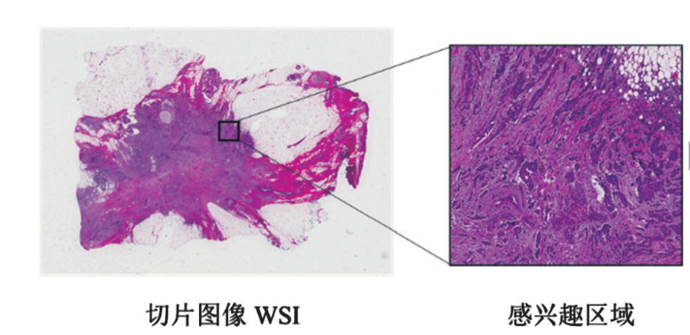
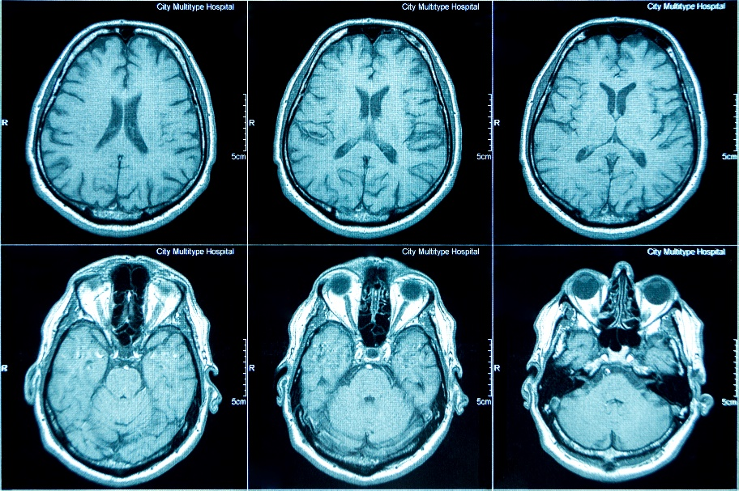
II) Longer Input in medical imaging
Motivations:
Pathology images are super large
It sometimes involves multiple images
This require large language models to receive longer input (which are quadratic to sequence length, challenging!!!)

Slide 18
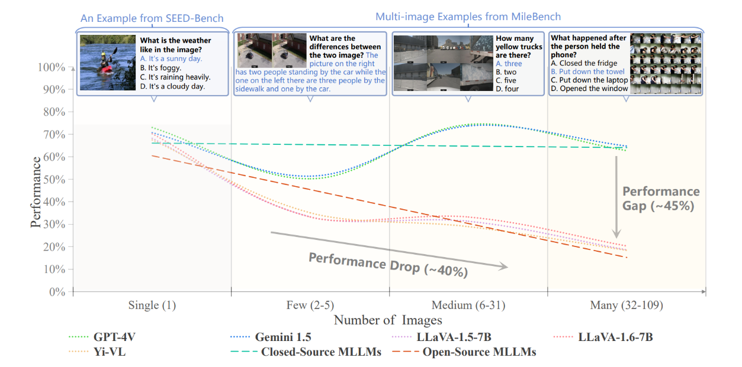
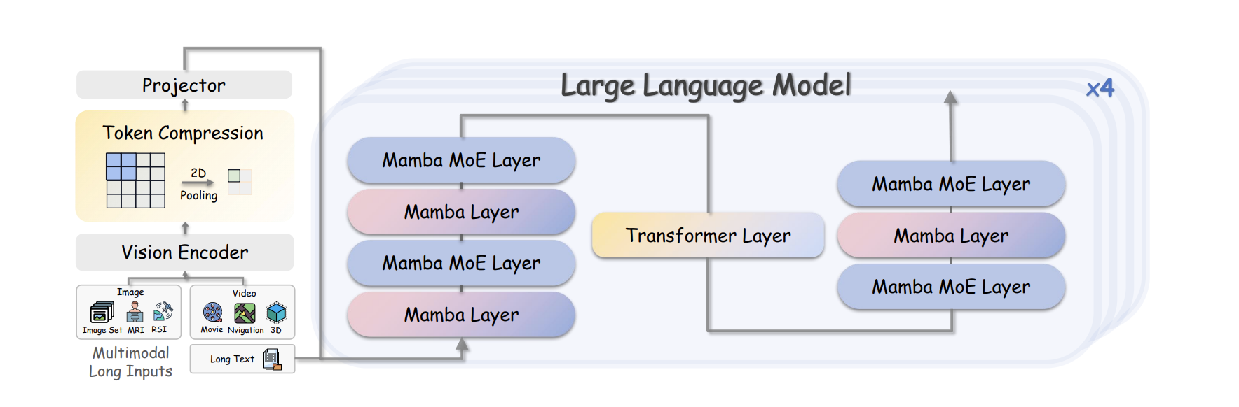
II）Our Long-context multimodal LLMs: LongLLaVA
Open-source models process long context poorly!
Our models (LongLLaVA) did it effectively and efficiently
Dingjie Song, et.al Benyou Wang. MILEBENCH: Benchmarking MLLMs in Long Context, COLM 2024. https://arxiv.org/abs/2404.18532
Xidong Wang, Dingjie Song, Shunian Chen, Junyin Chen, Zhenyang Cai, Chen Zhang, Lichao Sun, Benyou Wang. LongLLaVA: Scaling Multi-modal LLMs to 1000 Images Efficiently via a Hybrid Architecture. Findings of EMNLP 2025

Slide 19
III）Math reasoning to Medical reasoning
Starting from Math reasoning
在2025年第二届人工智能数学奥林匹克竞赛（AIMO2）中荣获金牌
联合杉数科技开发首个数学建模大模型 ORLM，并由该公司进一步升级为 COLORMind 平台投入实际业务应用。ORLM 的研究论文被国际顶级期刊《Operations Research》接收发表，标志着 AI 与运筹优化领域的深度融合。
Zhengyang Tang, Xingxing Zhang, Benyou Wang, Furu Wei. MathScale: Scaling Instruction Tuning for Mathematical Reasoning, ICML 2024
Zhengyang Tang, Chenyu Huang, Xin Zheng, Shixi Hu, Zizhuo Wang, Dongdong Ge, Benyou Wang. ORLM: Training Large Language Models for Optimization Modeling. Operations Research. https://arxiv.org/abs/2405.17743
Xuhan Huang, Qingning Shen, Yan Hu, Anningzhe Gao, Benyou Wang. Mamo: a Mathematical Modeling Benchmark with Solvers. Findings of NAACL 2024. https://arxiv.org/abs/2405.13144v1
Fei Yu, Anningzhe Gao, Benyou Wang. OVM, Outcome-supervised Value Models for Planning in Mathematical Reasoning. Findings of NAACL 2024. https://arxiv.org/abs/2311.13951
Kong, C., Yaxin, F.,Wan, X., Jiang, F. &Wang, B. (2024). Platolm: Teaching llms via a socratic questioning user simulator. In ACL 2024.
Haoran Li, Qingxiu Dong, Zhengyang Tang, Chaojun Wang, Xingxing Zhang, Haoyang Huang, Shaohan Huang, Xiaolong Huang, Zeqiang Huang, Dongdong Zhang, Yuxian Gu, Xin Cheng, Xun Wang, Si-Qing Chen, Li Dong, Wei Lu, Zhifang Sui, Benyou Wang, Wai Lam, Furu Wei. Synthetic data (almost) from scratch: Generalized instruction tuning for language models. https://arxiv.org/abs/2402.13064. TMLR
Wanlong Liu, Junxiao Xu, Fei Yu, Yukang Lin, Ke Ji, Wenyu Chen, Yan Xu, Yasheng Wang, Lifeng Shang, Benyou Wang. QFFT, Question-Free Fine-Tuning for Adaptive Reasoning. https://arxiv.org/abs/2506.12860 NeurIPS 2025
Chengpeng Li, Zhengyang Tang, Ziniu Li, Mingfeng Xue, Keqin Bao, Tian Ding, Ruoyu Sun, Benyou Wang, Xiang Wang, Junyang Lin, Dayiheng Liu. CoRT: Code-integrated Reasoning within Thinking. https://arxiv.org/abs/2506.09820 NeurIPS 2025
Tongxu Luo, Wenyu Du, Jiaxi Bi, Stephen Chung, Zhengyang Tang, Hao Yang, Min Zhang, Benyou Wang. Learning from Peers in Reasoning Models. https://arxiv.org/abs/2505.07787

Slide 20
Motivation: verifiable question from math to medical domain.
A key challenge in medical reasoning is verifying the thought process, which often lacks clear steps.
Question: Natalia sold clips to 48 of her friends in April, and then she sold half as many clips in May. How many clips did Natalia sell altogether in April and May?
Answer: 72
Question: Let $x$ , $y$ and $z$ all exceed $1$ and let $w$ be a positive number such that $\log_xw=24$ , $\log_y w = 40$ and $\log_{xyz}w=12$ . Find $\log_zw$ .
Answer: 60
GSM8K
AIME
Inspired by mathematical problems that allow verification through their outcomes.
(1) Their answers are definitive and unique.
(2) Guessing the answer is challenging.

Slide 21
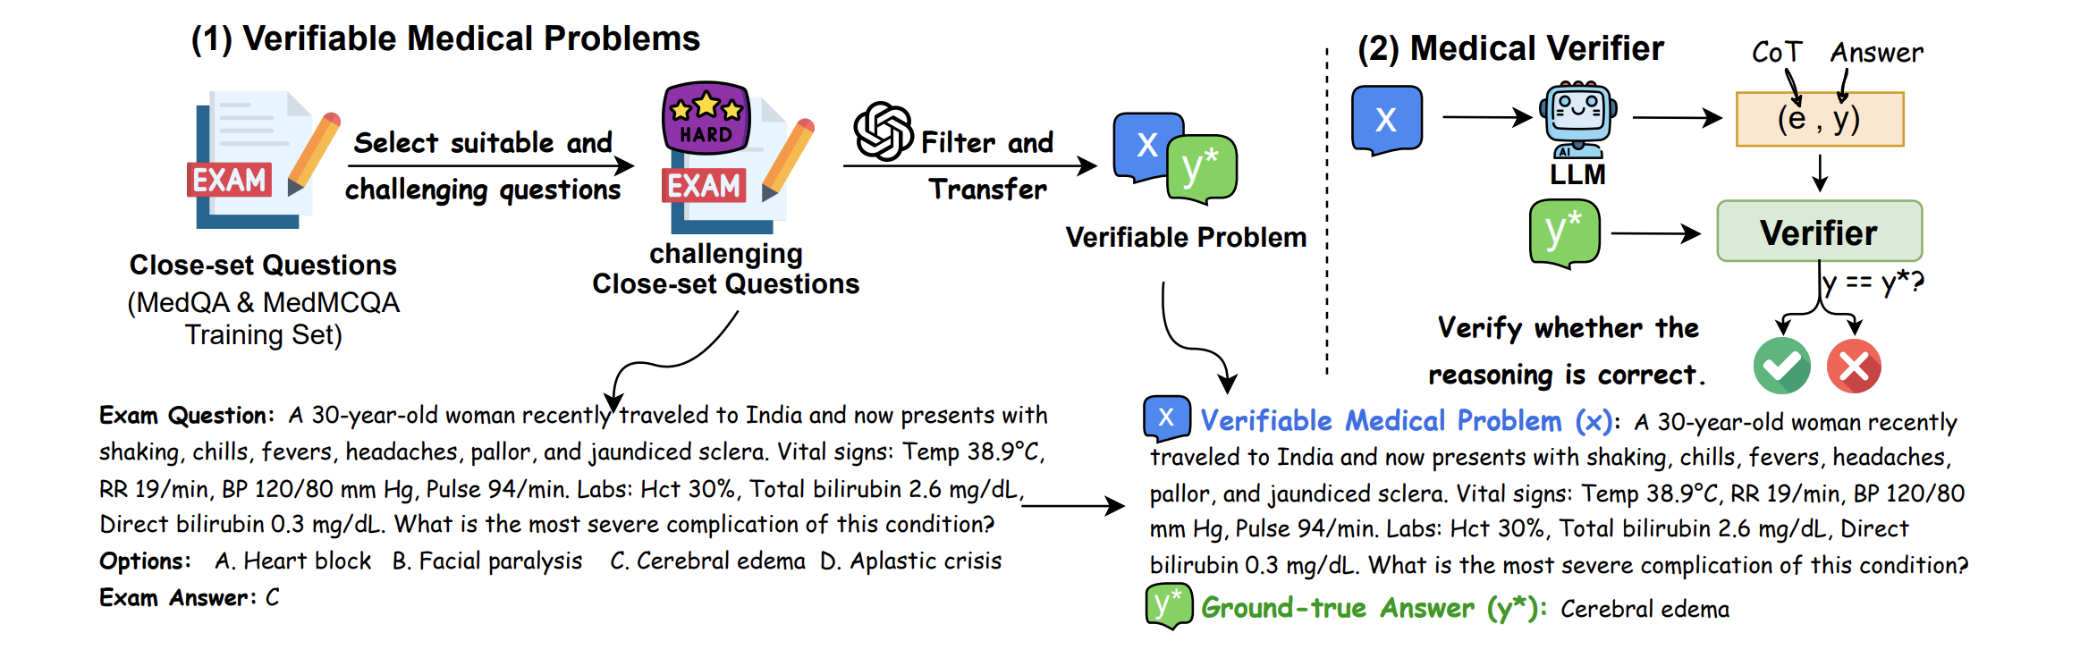
GMAI-Reasoning
RL with verifiable rewards works well in general domain (see Open O1 and the later Deepseek R1)
Where are Verifiable problems in medical domain?

Slide 22
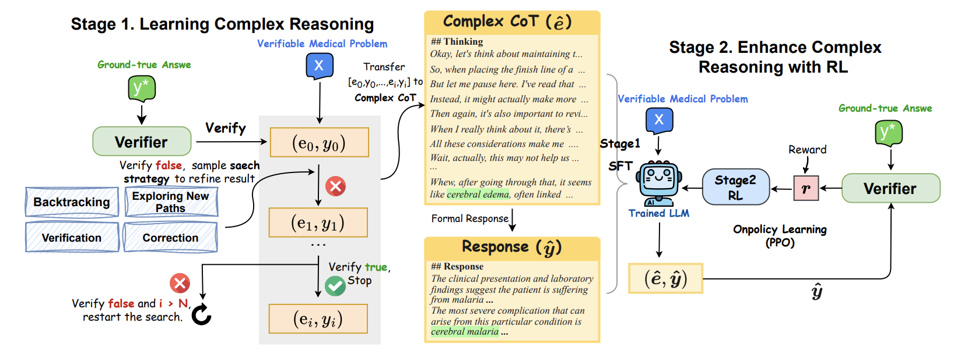
HuatuoGPT-o1
Junying Chen, Zhenyang Cai, Ke Ji, Xidong Wang, Wanlong Liu, Rongsheng Wang, Jianye Hou, Benyou Wang. HuatuoGPT-o1, Towards Medical Complex Reasoning with LLMs. Findings of ACL 2025.

Slide 23
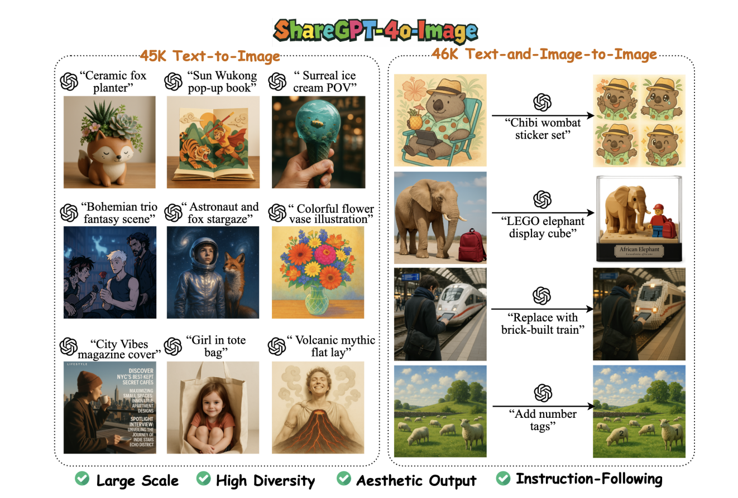
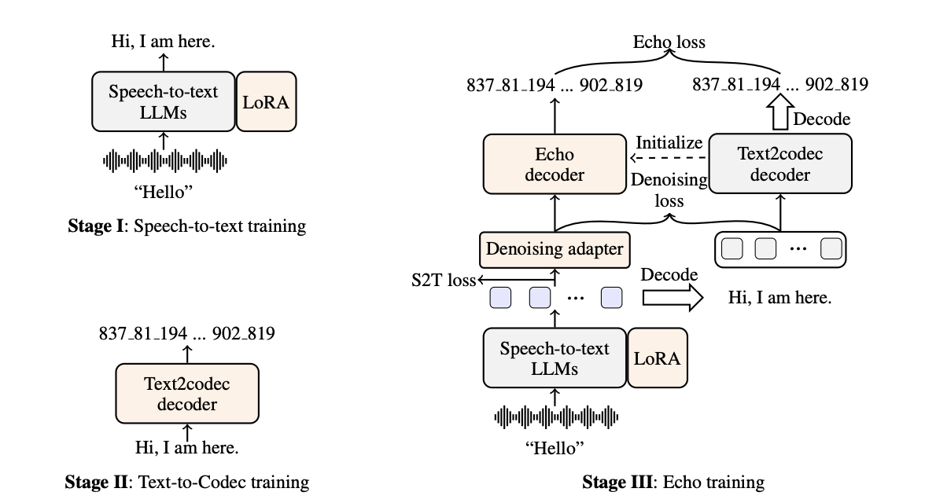
IV) Multi-modal Generation
EchoX：Speech to Speech generation
Janus：Image generation (editing)
One model generates everything!
Yuhao Zhang, Yuhao Du, Zhanchen Dai, Xiangnan Ma, Kaiqi Kou, Benyou Wang, Haizhou Li. Echox: Towards mitigating acoustic-semantic gap via echo training for speech-to-speech llms. https://arxiv.org/abs/2509.09174
Junying Chen, Zhenyang Cai, Pengcheng Chen, Shunian Chen, Ke Ji, Xidong Wang, Yunjin Yang, Benyou Wang. ShareGPT-4o-Image: Aligning Multimodal Models with GPT-4o-Level Image Generation. https://arxiv.org/abs/2506.18095

Slide 24
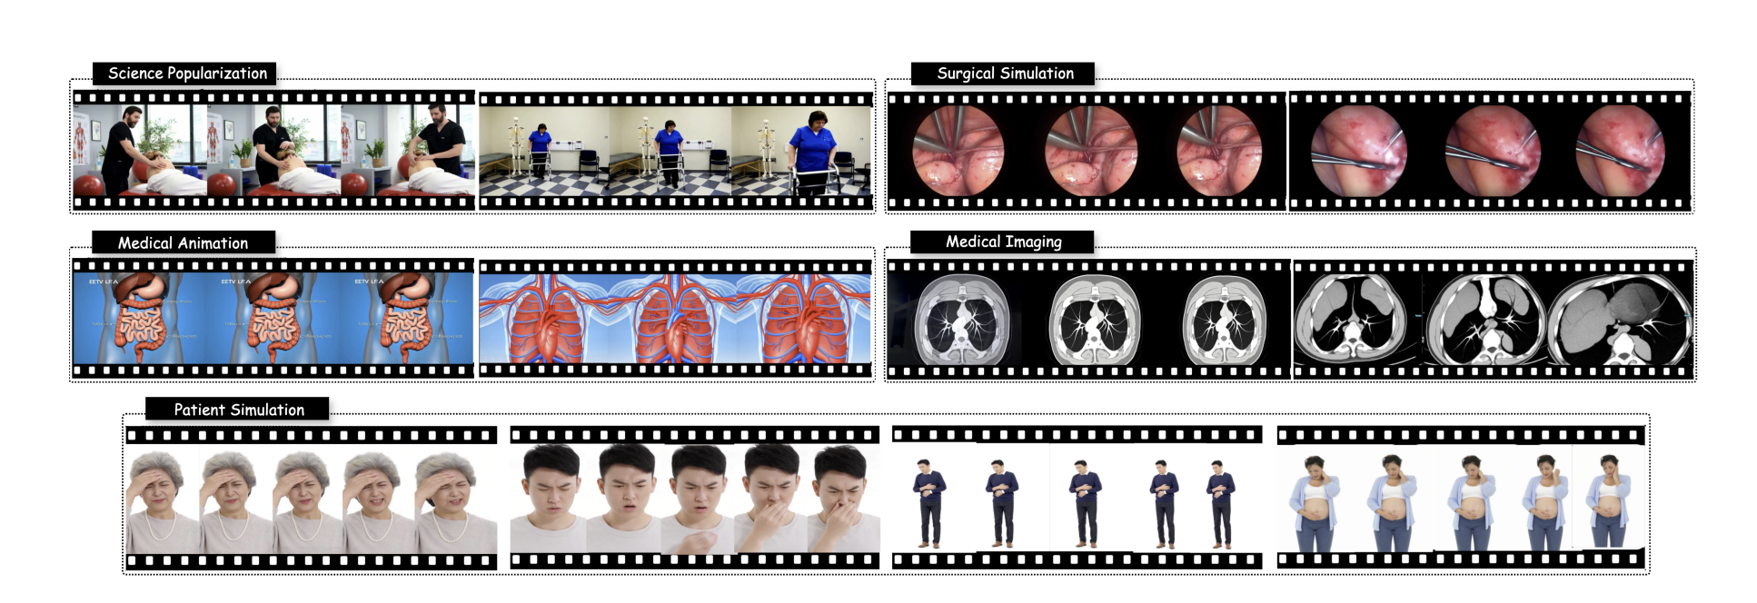
Medical Video Generation： MedGen
Rongsheng Wang, Junying Chen, Ke Ji, Zhenyang Cai, Shunian Chen, Yunjin Yang, Benyou Wang. MedGen: Unlocking Medical Video Generation by Scaling Granularly-annotated Medical Videos. https://arxiv.org/abs/2507.05675

Slide 25
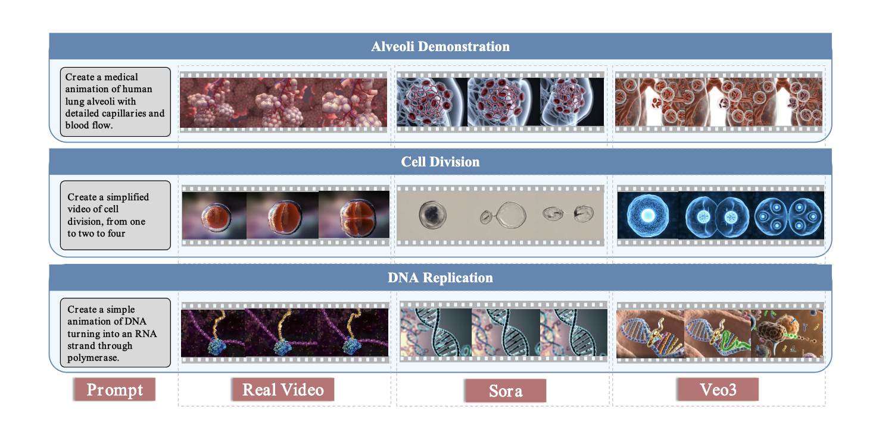
Micro World Simulation (MicroVerse)
Rongsheng Wang, Minghao Wu, Zhou Hongru, Zhihan Yu, Zhenyang Cai, Junying Chen, Benyou Wang. MicroVerse: A Preliminary Exploration Toward a Micro-World Simulation. ICLR 2026

Slide 26
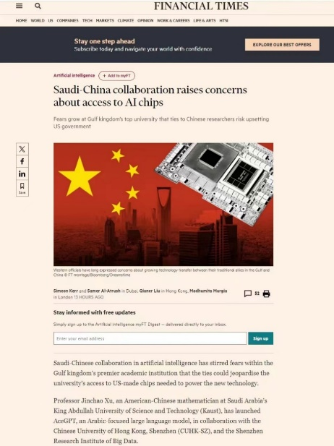
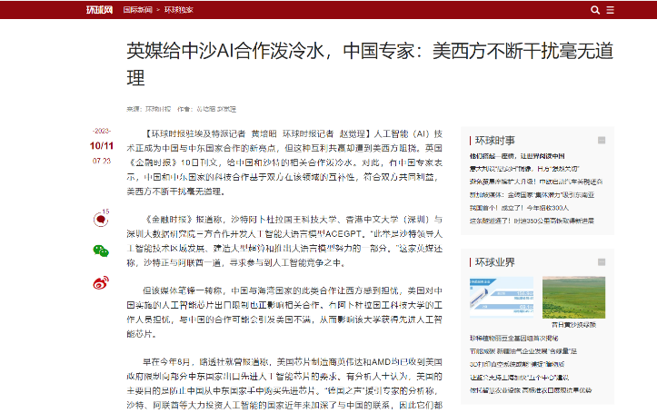
多语言大模型
AceGPT是发布时最好的阿拉伯语大模型，使用了三千多张910A芯片
  Arabic LLMs
    AceGPT： value alignment for a new language (Arabic)
    AceGPT 1.5: vocabulary expansion
    AceGPT 2: native alignment
  Apollo and Apollo-MoE 多语言医疗大模型
[1] Huang Huang, Fei Yu, Jianqing Zhu, Xuening Sun, Hao Cheng, Dingjie Song, Zhihong Chen, Abdulmohsen Alharthi, Bang An, Ziche Liu, Zhiyi Zhang, Junying Chen, Jianquan Li, Benyou Wang, Lian Zhang, Ruoyu Sun, Xiang Wan, Haizhou Li, Jinchao Xu. AceGPT, Localizing Large Language Models in Arabic. NAACL 2024
[2] Jianqing Zhu, Huang Huang, Zhihang Lin, Juhao Liang, Zhengyang Tang, Khalid Almubarak, Mosen Alharthi, Bang An, Juncai He, Xiangbo Wu, Fei Yu, Junying Chen, MA Zhuoheng, Yuhao Du, Yan Hu, He Zhang, Emad A. Alghamdi, Lian Zhang, Ruoyu Sun, Haizhou Li, Jinchao Xu, Benyou Wang. Second Language (Arabic) Acquisition of LLMs via Progressive Vocabulary Expansion. Submitted to COLM 2024
[3] Juhao Liang, Zhenyang Cai, Jianqing Zhu, Huang Huang, Kewei Zong, Bang An, Mosen Alharthi, Juncai He, Lian Zhang, Haizhou Li, Benyou Wang, Jinchao Xu. Alignment at Pre-training! Towards Native Alignment for Arabic LLMs. Submitted to NeurIPS 2024
[4] Xidong Wang, Nuo Chen, Junyin Chen, Yidong Wang, Guorui Zhen, Chunxian Zhang, Xiangbo Wu, Yan Hu, Anningzhe Gao, Xiang Wan, Haizhou Li, Benyou Wang. Apollo: A Lightweight Multilingual Medical LLM towards Democratizing Medical AI to 6B People. https://arxiv.org/abs/2403.03640
[5] Guorui Zheng, Xidong Wang, Juhao Liang, Nuo Chen, Yuping Zheng, Benyou Wang. Efficiently Democratizing Medical LLMs for 50 Languages via a Mixture of Language Family Experts. ICLR 2025

Slide 27
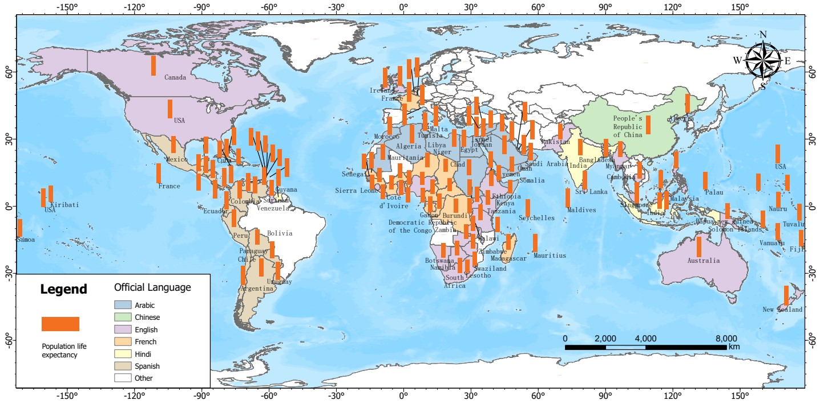
V) Multi-lingual support
Democratizing Medical AI to 6B People
Motivations:
Medical knowledges might be agnostic to languages
It lacks rich medical corpora for some low-resources languages
“Be vaccinated could reduce the symptom of COVID-19”, it works for every language!
[1] Xidong Wang, Nuo Chen, Junyin Chen, Yidong Wang, Guorui Zhen, Chunxian Zhang, Xiangbo Wu, Yan Hu, Anningzhe Gao, Xiang Wan, Haizhou Li, Benyou Wang. Apollo: A Lightweight Multilingual Medical LLM towards Democratizing Medical AI to 6B People. https://arxiv.org/abs/2403.03640
[2] Guorui Zheng, Xidong Wang, Juhao Liang, Nuo Chen, Yuping Zheng, Benyou Wang. Efficiently Democratizing Medical LLMs for 50 Languages via a Mixture of Language Family Experts. ICLR 2025

Slide 28
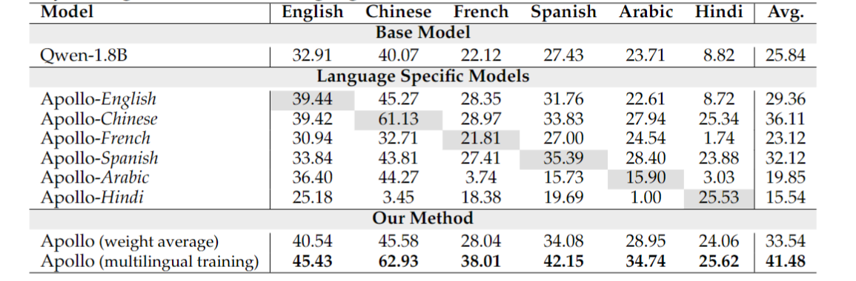
On the complementarity between languages
Average accuracy in individual languages

Slide 29
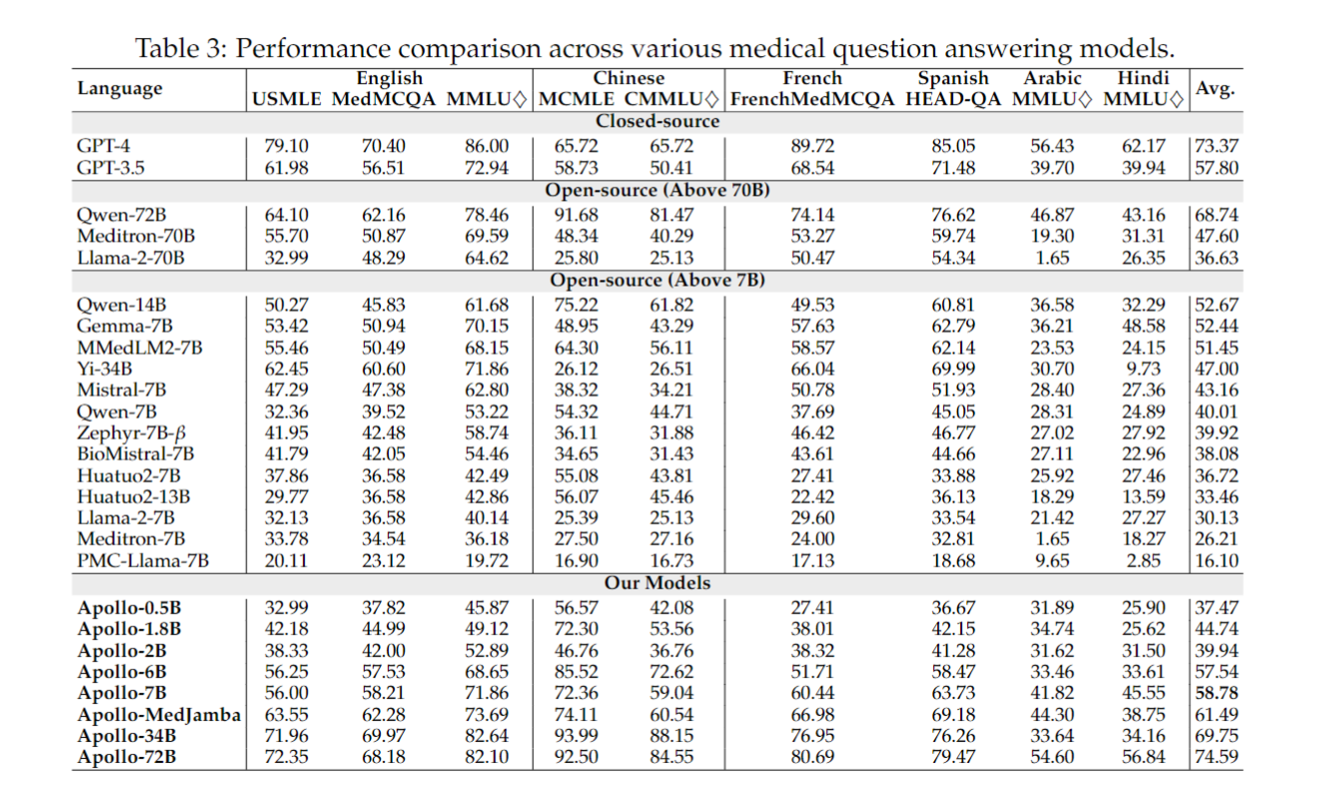
V) Apollo, the first multilingual medical LLMs
[1] Xidong Wang, Nuo Chen, Junyin Chen, Yidong Wang, Guorui Zhen, Chunxian Zhang, Xiangbo Wu, Yan Hu, Anningzhe Gao, Xiang Wan, Haizhou Li, Benyou Wang. Apollo: A Lightweight Multilingual Medical LLM towards Democratizing Medical AI to 6B People. https://arxiv.org/abs/2403.03640
[2] Guorui Zheng, Xidong Wang, Juhao Liang, Nuo Chen, Yuping Zheng, Benyou Wang. Efficiently Democratizing Medical LLMs for 50 Languages via a Mixture of Language Family Experts. ICLR 2025

Slide 30
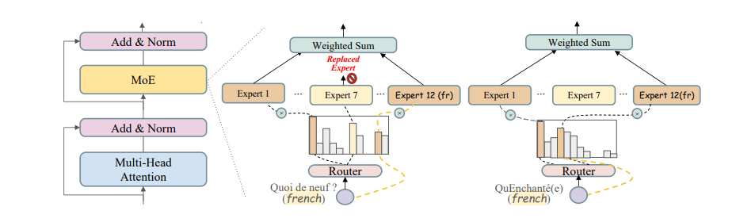
Apollo-2： Democratizing Medical LLMs for 50 Languages
Efficiently Democratizing Medical LLMs for 50 Languages via a Mixture of Language Family Experts. Guorui Zheng , Xidong Wang , Juhao Liang, Nuo Chen, Yuping Zheng, Benyou Wang∗. https://arxiv.org/pdf/2410.10626. ICLR 2025

Slide 31
Roadmap to Generalist Medical AI (GMAI)
What is Generalist Medical AI?
Roadmap to Generalist Medical AI
  Perception :
    I) Multi-modal Perception
    II) Longer Context
  Cognition: III) Better Reasoning
  Interaction:
    IV) Multi-modal Generation
    V) Agent Simulation : Twin Hospital
  Multilingual Support
    VI) Multilingual Medical LLMs: Apollo
Our Strategies

Slide 32
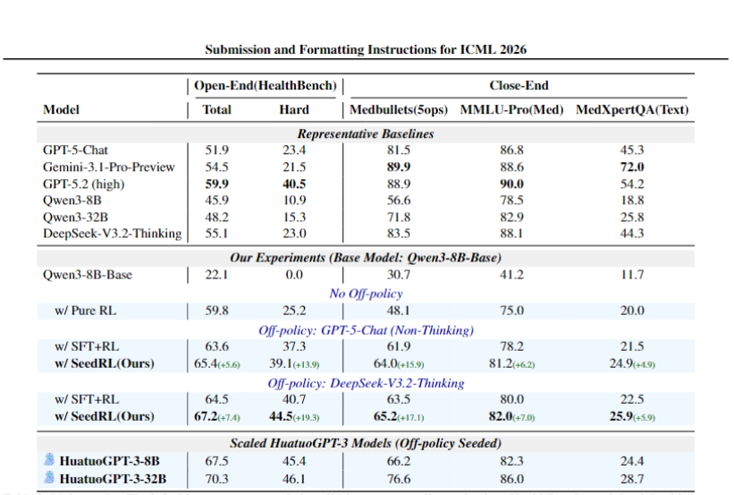
Strategy I: Foundational medical LLMs (HuatuoGPT-III)
Junying Chen, Xinyuan Xie, et.al. HuatuoGPT-3: RL-Only Domain Adaptation from Base Models via Off-Policy Seeding.

Slide 33
Challenges: Decentralized Data:
GMAI is the final goal
The road towards this goal might involves different specialized Multi-modal LLMs
OpenAI etc. develop one model for all
Academic community build Lego blocks and merge them
Better model backbone
Better insights/data/benchmark
Different specialized models since data are decentralized
Yidong Wang, Xidong Wang, Yujie He, Zhenyang Cai, Guo Zhu, Dexiang Yang, Mian Wang, Prayag Tiwari, Yan Hu, Benyou Wang. Towards Specialized Medical LLMs, A Comprehensive Study.

Slide 34
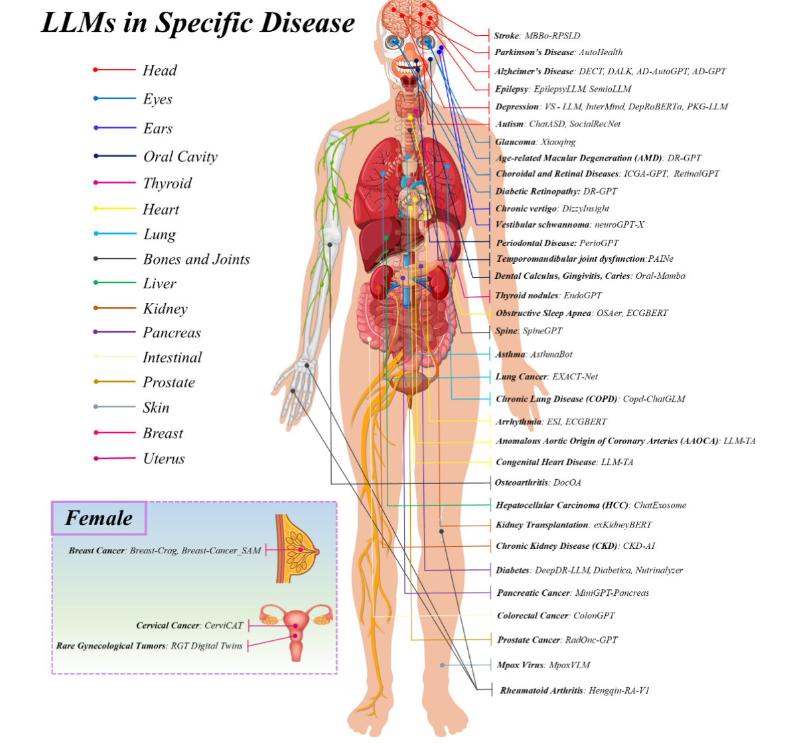
Strategy II: Specialied medical large language models
专病和通用大模型的关系
  competitive vs. cooperative?
    替代
    Routing
    SMLLM as tools
    SMLLM- MLLM distillation
    MoE
Yidong Wang et.al，Benyou Wang. Towards Specialized Medical LLMs, A Comprehensive Study. In progress

Slide 35
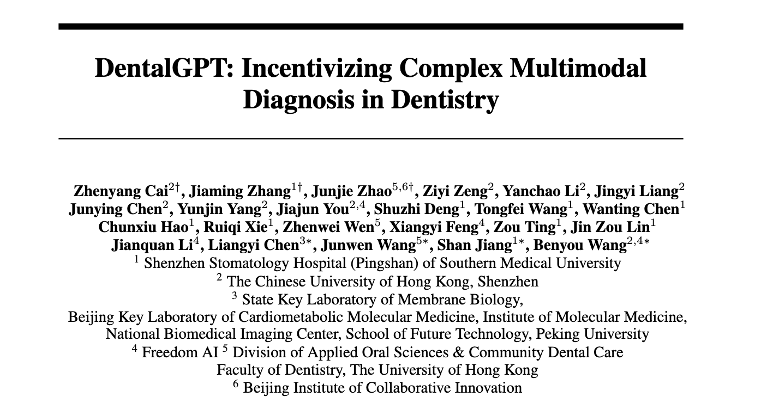
各个击破
牙医大模型
中医大模型
EEG脑电大模型
病理大模型
与港大牙医学院/南方医科大学深圳口腔医院（坪山）合作共建

Slide 36
通专融合：深耕专科
链接专科机构和专家
找到专科的具体问题, 做完即用
和多个专科医院共做评测
用AI和专家一起来标注；并通过专科科普来链接更多的专家
医疗科普和医疗专业教育
Notes:
联合南方医科大学附属坪山口腔医院申请到深圳医科院项目（200万），做儿童社区龋齿筛查
联合坪山区教育局 走进中小学进行筛查（坪山区教育局已开始配合意）
在港中深基础教育集团试点筛查
多个机构支持参与深圳中小学口腔普查启动仪式

Slide 37
Strategy III: Agentic Hospital
人物模拟
  虚拟的病人[1]和医生
  技术需求逼真的音视频同步技术[2,3,4]，病人模拟智能体；
社会交互模拟
  医院内决策实体之间的交互（对话、书写报告、药品购买支付）
物理空间模拟
  拿到医院的建筑图纸，无人机拍摄，高斯泼溅技术重构3D
世界机制模拟
  医保支付机制、导诊机制、排班运营、全流程就诊。
  个人/机构的决策机制（趋利避害，人性使然）
  真实数据交互系统（Health Information System）
[1] Bingquan Zhang, Xiaoxiao Liu, Yuchi Wang, Lei Zhou, Qianqian Xie, Benyou Wang. Human or LLM as Standardized Patients? A Comparative Study for Medical Education. https://arxiv.org/abs/2511.14783
[2] Bingquan Liu, Xiang Li, Benyou Wang. HealthTTS, Synthesize Speech with Health Conditions for Simulated Patients. Prepare to submit to NeurIPS 2026.
[3] Shunian Chen, Hejin Huang, Yexin Liu, Zihan Ye, Pengcheng Chen, Chenghao Zhu, Michael Guan, Rongsheng Wang, Junying Chen, Guanbin Li, Ser-Nam Lim, Harry Yang, Benyou Wang. TalkVid: A Large-Scale Diversified Dataset for Audio-Driven Talking Head Synthesis. https://arxiv.org/abs/2508.13618
[4] Rongsheng Wang, Junying Chen, Ke Ji, Zhenyang Cai, Shunian Chen, Yunjin Yang, Benyou Wang. MedGen: Unlocking Medical Video Generation by Scaling Granularly-annotated Medical Videos. https://arxiv.org/abs/2507.05675

Slide 38
真实HIS系统的好处
数据在虚拟医院和真实医院无缝切换
在虚拟医院里面的任何AI辅助工具，可以无缝切入到真实系统
支持：
  港中深医院已经在我们学校服务器上部署有真实医院的HIS系统
  有一些初步的样例数据可控使用

Slide 39
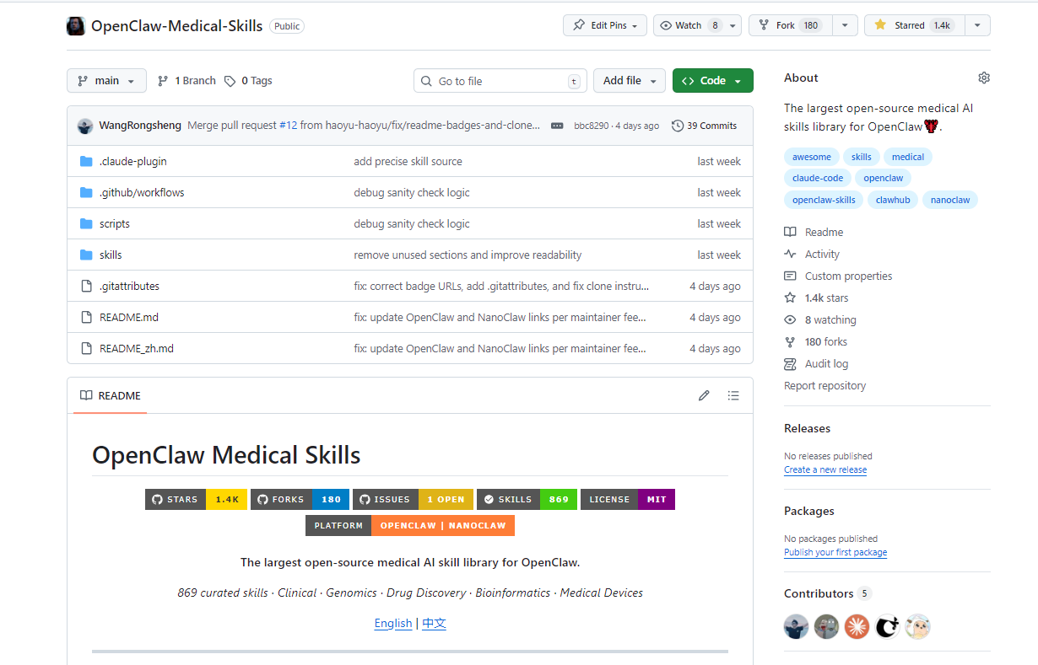
Medical Skills

Slide 40
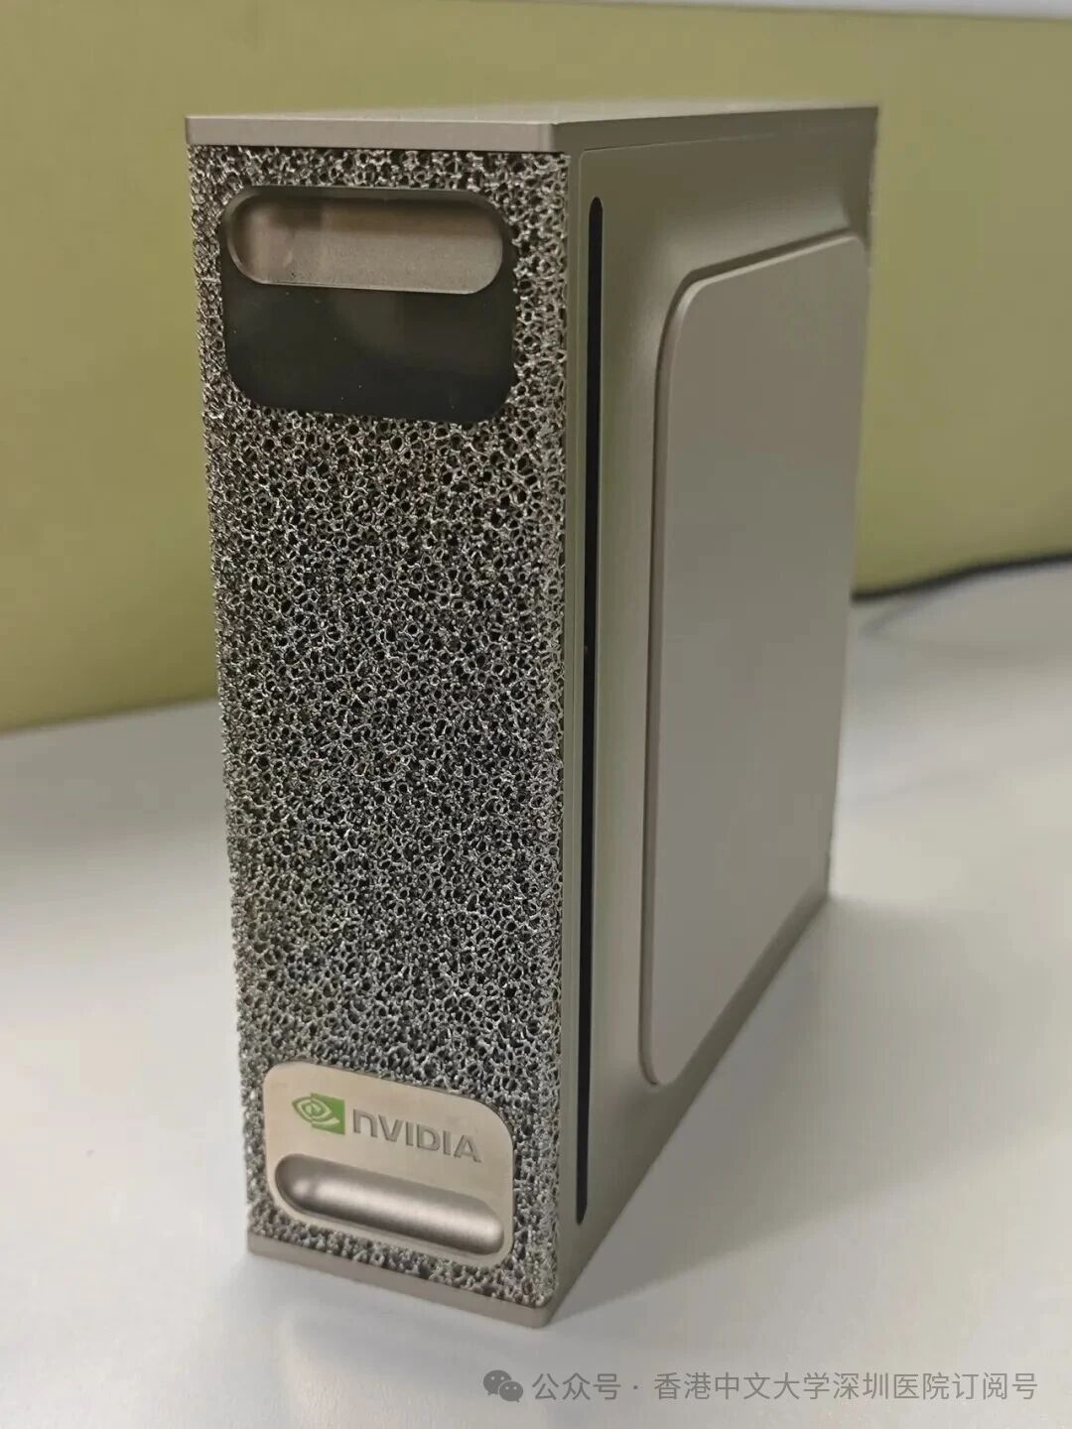
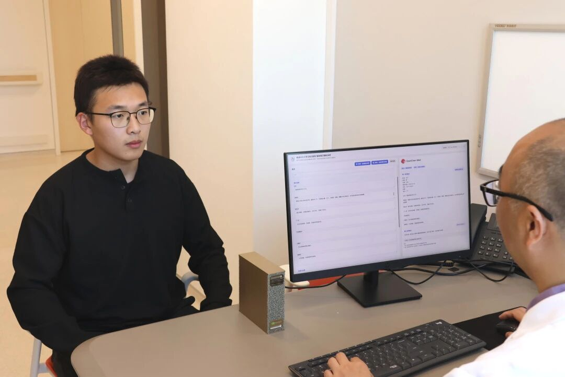
OpenClaw 在港中深医院

Slide 41
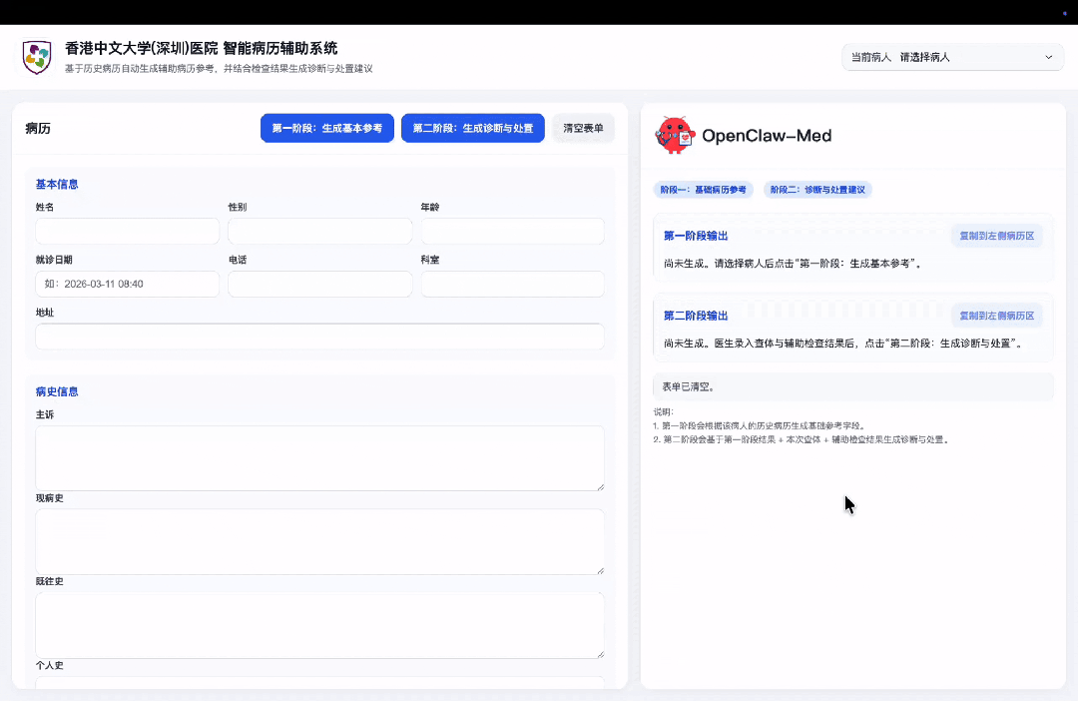
OpenClaw 在港中深医院

Slide 42
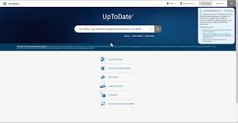
AI-native Up-to-Date
AI生成基础的医疗内容内容
  完备的内容体系
  基于循证医疗（指南、Wikipedia）
通过社区来自助驱动内容更新
  专家以修改内容为荣（“于院认证的儿科专家”）
  AI帮助修改
  有激励机制来让专家有获得感
    获得免费Gemini和Anthropic的API访问和流畅的Agent体系
相关工作：KBAgent：
  使用AI和专业文档一起构建全科和专科的知识图谱
  让专家来校验，最后在智能体应用里通过用户反馈慢慢修正
直接提供循证API，加上检索器

Slide 43
Strategy IV: Benchmark Engineering
评测需要共识和头部玩家支持！

Slide 44
Evaluation 1：Doctors' Last Exam
更新机制：滚动，每个月度（或季度）更新一下，写白皮书 （这个idea我们和蚂蚁医疗一起投了一篇论文LiveClin https://openreview.net/forum?id=E0WSAugJ0j）
评测机制：A/B 榜单，A榜只公开题目，不公开答案； B榜题目题目和答案都不公开（用户提交模型来测试）
生产机制：主要由题目由专家来出，一个并行的track通过智能体自动合成题目（未来希望后者来替代前者），每一道题都有专家电子签。
数据范式：用healthbench的思路，通过rubrics 来评估。（优先推rubrics，但是并不完全设定死类型）
合作模式：说服九坤、百川、蚂蚁医疗、商汤医疗一起来共建（比如捐赠）
质量要求：题目不在多，在于精，每道题都由专家出，每道题都有出题人的署名；有专门的委员会来鉴定题目好坏，好的题目可以有奖励机制
Xidong Wang, Guo Shuqi, Yue Shen, Junying Chen, Jian Wang, Jinjie Gu, Ping Zhang, Lei Liu, Benyou Wang. LiveClin: A Live Clinical Benchmark without Leakage. ICLR 2026.
Notes:
- 后续扩展：有医院愿意合作的话可以提供内部脱敏数据来共建优势科室垂域/专科评测集合。
结果反馈形式： 平台操作 / sdk代码操作 两种发起评测方式，均自动产生评测结果报告，可附加技术专家及医学专家的报告复核认证（报告上签署专家电子签）
- 集合范式：建立一个大的分科/难度分层/类型 框架，每道题在产生初期就有 学科、难度、类型、涉及知识点等结构化属性。

Slide 45
Evaluation 2：基于Agent路由的评估平台
智能体应用需要有reputation和流量
  C端的影响力：产品本身通过开发者一个视频就可以社交传播！
在智能体应用里面看实际的效果
每个季度出新的技术报告 （例如OpenRouter技术报告）

Slide 46
Strategy V: Medical Education
Happy-medical-AI项目
  https://github.com/FreedomIntelligence/HappyMedicalAI
  面向医疗从业人员的人工智能培训，培养和AI协作的医生
基于病人孪生的医生教育
  模拟病人训练医生[1,2]，音视频技术在加速开发（音视频同步，数字人生成，HealthTTS）
  全模态病人数据合成（提供AI和真人医生最佳训练环境）
医疗科普教育
  视频生成MedGen
  插图生成
  微观世界模拟器
AI教育从娃娃抓起，未来功德无量
[1] Zhiqi Gao, Guo Zhu, Huarui Luo, Dongyijie Primo Pan, Haoming Tang, Bingquan Zhang, Jiahuan Pei, Jie Li, Benyou Wang. " It Talks Like a Patient, But Feels Different": Co-Designing AI Standardized Patients with Medical Learners. ACM CHI 2026.
[2] Bingquan Zhang, Xiaoxiao Liu, Yuchi Wang, Lei Zhou, Qianqian Xie, Benyou Wang. Human or LLM as Standardized Patients? A Comparative Study for Medical Education. Submitted to ACL 2026 (meta score：3.5).

Slide 47
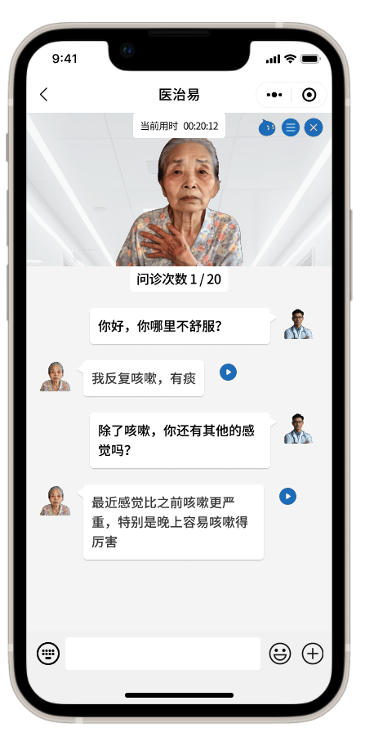
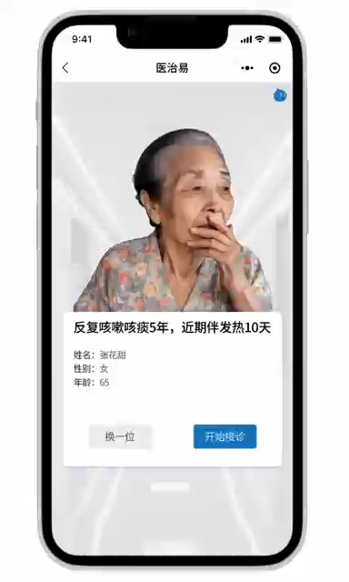
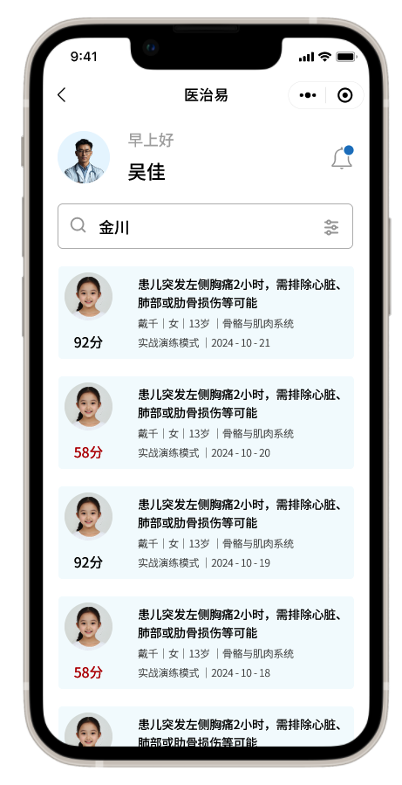
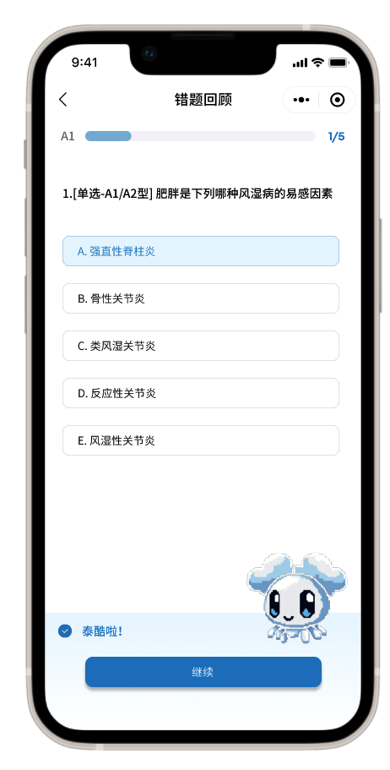
医疗教育
在真实医院场景，通过模拟病人来训练医生
自研MedGEN视频生成模型
自研TTSLoRAHub语音合成技术
自研HeadVid音频同步数字人技术

Slide 48
Strategy VI: Digital Twin for Healthcare
    虚拟细胞，器官
    生命体征数据的模拟
    虚拟病人交互
    虚拟医院
    This plays as the environment role for agent (human/AI doctors) training

Slide 49
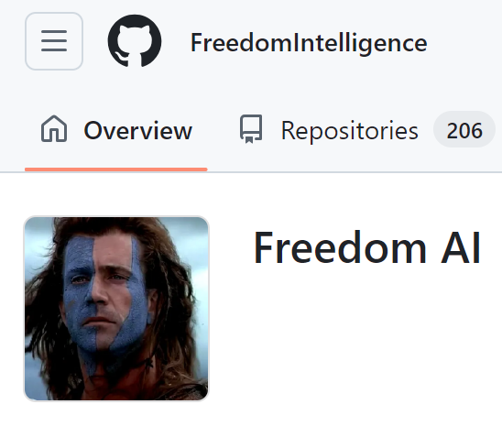


将基于医疗教育构建医生社区，构建普惠、开放的医疗人工智能生态。
科普：
  自己做 构建医疗AI的新媒体，通过AI来做科普，为社会带来AI科普和医疗教育的应用；
  帮人做 提供科普工具，通过AI科普工具和医生一起科普，为泛医疗社区提供提升国民医疗素养。
科研：所有的平台、社区、数据、模型和场景将对全球免费开源共享。
  模型：和顶级医院和顶级科室训练专病大模型，各个击破 (HuggingFace) ，开源开放最新的大语言模型 (GitHub) ；
  智能体：协同构建医疗工具集，通过MCP协议标准化医疗智能体；
  评测：根据社区的实际医疗需求，构建医疗大模型评测标准，构建医疗AI伦理标准与评测体系；
  数据集：和医生社区共建开放数据库，开源全球多语言医疗语料库和知识库（含标准化病例、医疗语料、医疗评测、中医数据库）；
线上线下互动： 提供本地医疗社区线下活动和线上讲座报告，走访医学院和医院，以线下医学院和医院为基础构建社区，构建微信群、discard群等；医疗人工智能的生态大会；线下走访高校、医学院科研交流，分享产品、科研和社区
商业：通过社区可以接触更优质的项目；接触最真实的用户需求，为构建产品做准备；更加专家接触，可以提供更好的反馈和标注，形成模型的壁垒；通过社区招聘优秀的实习生和员工；

Slide 50

Thanks
wangbenyou@cuhk.edu.cn

